Slide 1
Determinants of Perceived Health: Dietary Habits, Socioeconomic Factors, Physical Activity, and Personal Metrics
A 2019 and 2021 SMART BRFSS City and County Data Analysis
By: Obinna Dinneya
Student number: 501217859

Slide 2
INTRODUCTION
This health data project explores the often-overlooked aspect of self-perceived health, delving into why some people feel healthier than others despite similar conditions.
We investigate not just visible factors like diet and exercise but also subtle influences like cultural background and everyday challenges.
This comprehensive approach aims to weave a rich tapestry of perceived health, considering origins, societal contexts, and personal struggles to fully understand well-being."

Slide 3
RESEARCH QUESTIONS
How do dietary habits, specifically the consumption of fruits and green vegetables, relate to overall health outcomes and perceived health predictions?
How does socioeconomic status, emphasizing racial and ethnic backgrounds, influence healthcare access and overall health outcomes?
How does regular physical exercise influence tangible health outcomes, such as the risk of developing cancer, and mental health outcomes, including the likelihood of being diagnosed with depression?
Is there a correlation between Chronic conditions and individuals' self-assessed health status?
Can perceived health be accurately predicted using dietary habits, socioeconomic indicators, lifestyle choices, and individual metrics?

Slide 4
METHODOLOOGY,APPROACH AND TOOLS

Slide 5
METHODOLOOGY,APPROACH AND TOOLS

Slide 6
FINDINGS AND RESULTS
RESEARCH QUESTION 1
How do dietary habits, specifically the consumption of fruits and green vegetables, relate to overall health outcomes and perceived health predictions?
*Wallace et al. (2020): Health Impacts of Fruit & Vegetable Intake
Conducted an umbrella review analyzing recent clinical trials and observational studies.
Findings of research:
“The scientific evidence for providing public health recommendations to increase F&V consumption for prevention of disease is strong.
Current evidence suggests that F&V have the strongest effects in relation to prevention of CVDs, noting a nonlinear threshold effect of 800 g per day (i.e., about 5 servings a day).” *Not directly Proportional*
A.) Comparison between the daily dark Vegetable Consumption between individuals with perceived good health Vs perceived fair or poor health using statistical analysis.
Unpaired One-sided Sample T-test Results:
Null Hypothesis (H₀):
Mean daily intake of dark green vegetables for those with perceived good health ≤ those with perceived bad health.
Alternative Hypothesis (H₁):
Mean daily intake of dark green vegetables for those with perceived good health > those with perceived bad health.
confidence interval = 95%
pvalue < 0.05(alpha) ; this indicates that we reject the null hypothesis
pvalue < 0.01 this also shows that the results are highly statistically significant

Slide 7
FINDINGS AND RESULTS
RESEARCH QUESTION 1
How do dietary habits, specifically the consumption of fruits and green vegetables, relate to overall health outcomes and perceived health predictions?
*Wallace et al. (2020): Health Impacts of Fruit & Vegetable Intake
Conducted an umbrella review analyzing recent clinical trials and observational studies.
Findings of research:
“The scientific evidence for providing public health recommendations to increase F&V consumption for prevention of disease is strong.
Current evidence suggests that F&V have the strongest effects in relation to prevention of CVDs, noting a nonlinear threshold effect of 800 g per day (i.e., about 5 servings a day).” *Not directly Proportional*
B.) Comparing the daily fruit Consumption between individuals with perceived good health Vs perceived bad health.
Unpaired One-sided Sample T-test Results:
Null Hypothesis (H₀): Mean daily intake of fruits for those with perceived good health ≤ those with perceived fair or poor health.
Alternative Hypothesis (H₁): Mean daily intake of fruits for those with perceived good health > those with perceived fair or poor health.
confidence interval = 95%
pvalue < 0.05(alpha) ; this indicates that we reject the null hypothesis
pvalue < 0.01 this also shows that the results are highly statistically significant

Slide 8
FINDINGS AND RESULTS
RESEARCH QUESTION 1
*Wallace et al. (2020): Health Impacts of Fruit & Vegetable Intake
Conducted an umbrella review analyzing recent clinical trials and observational studies.
Findings of research:
“Current evidence suggests that F&V have the strongest effects in relation to prevention of CVDs, noting a nonlinear threshold effect of 800 g per day (i.e., about 5 servings a day).”
*Not directly Proportional*
C.) Do F&V when consumed in quantities around five servings daily, exhibit potent preventive effects against Cardiovascular Disease?
Unpaired One-sided Sample T-test Results:
Null Hypothesis (H₀): Mean total CVD cases for those who eat less than 5 servings of F&V ≤ mean total CVD cases for those who eat 5 or more servings of F&V.
Alternative Hypothesis (H₁): Mean total CVD cases for those who eat less than 5 servings of F&V > mean total CVD cases for those who eat 5 or more servings of F&V.
Confidence interval = 95%
pvalue < 0.05(alpha) ; this indicates that we reject the null hypothesis
pvalue < 0.01 this also shows that the results are highly statistically significant

Slide 9
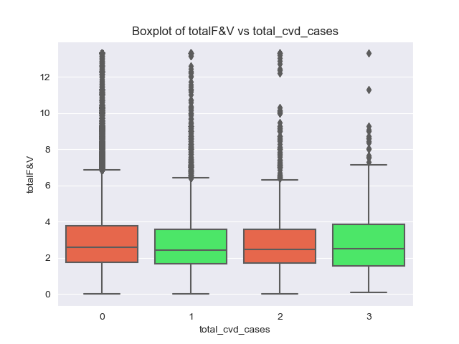
FINDINGS AND RESULTS
Total F&V:
Refers to the total daily consumption of fruits and vegetables
Total CVD Cases represents the total of all cardiovascular diseases that each individual has reported having or had in the past.
CVD:
-Heart Attack or MI
-Angina or CHD
-Stroke

Slide 10
FINDINGS AND RESULTS
RESEARCH QUESTION 2
How does socioeconomic status, emphasizing racial and ethnic backgrounds, influence healthcare access and overall health outcomes?
*Towne Jr., S. D. (2017): Socioeconomic, Geospatial, and Geopolitical Disparities in Access to Health Care in the US 2011–2015
Conducted a multivariate logistic regression Analysis.
Findings :
Found significant associations( p < 0.05) btw race/ethnicity, education, income and sex and likelihood of forgoing medical care in the United States.

Slide 11
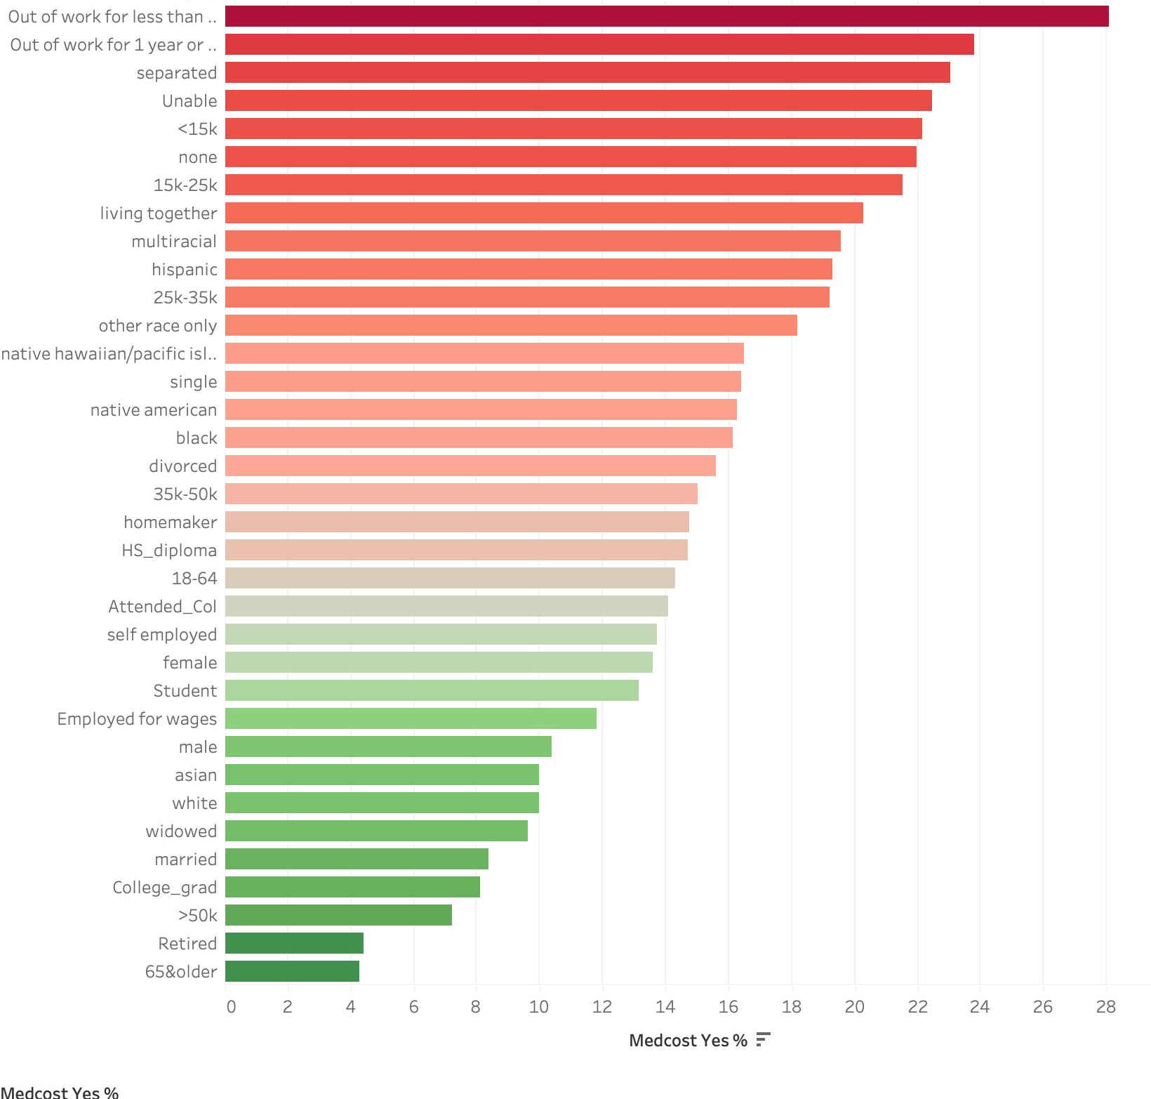
Distribution of Percentage Forgone Medical Care Based on Socio-Economic Subcategories
INSIGHTS FROM 2019 BRFSS ANALYSIS
~24% of Those who were unemployed for under a year
Opted out on medical care because of cost.
Only ~4% of those 65 years and older as well as those who are retired report opting out of Medical care because of cost
Minorities (Black and Hispanic) show much higher rates of Forgone Medical Care compared to White individuals.
Higher Educated individuals (college graduates) report lower rates of forgone Medical Care

Slide 12
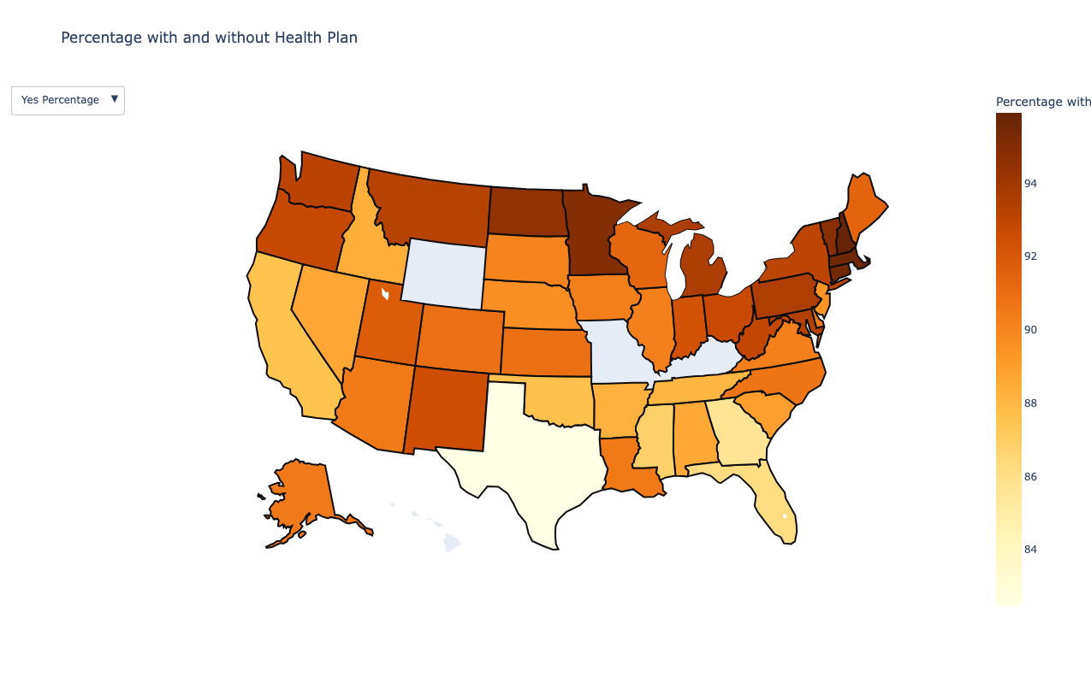

Slide 13
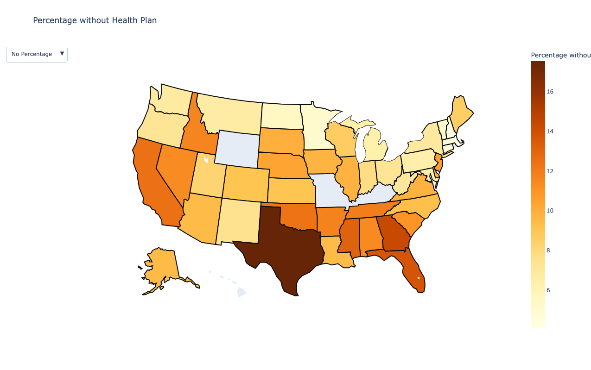

Slide 14
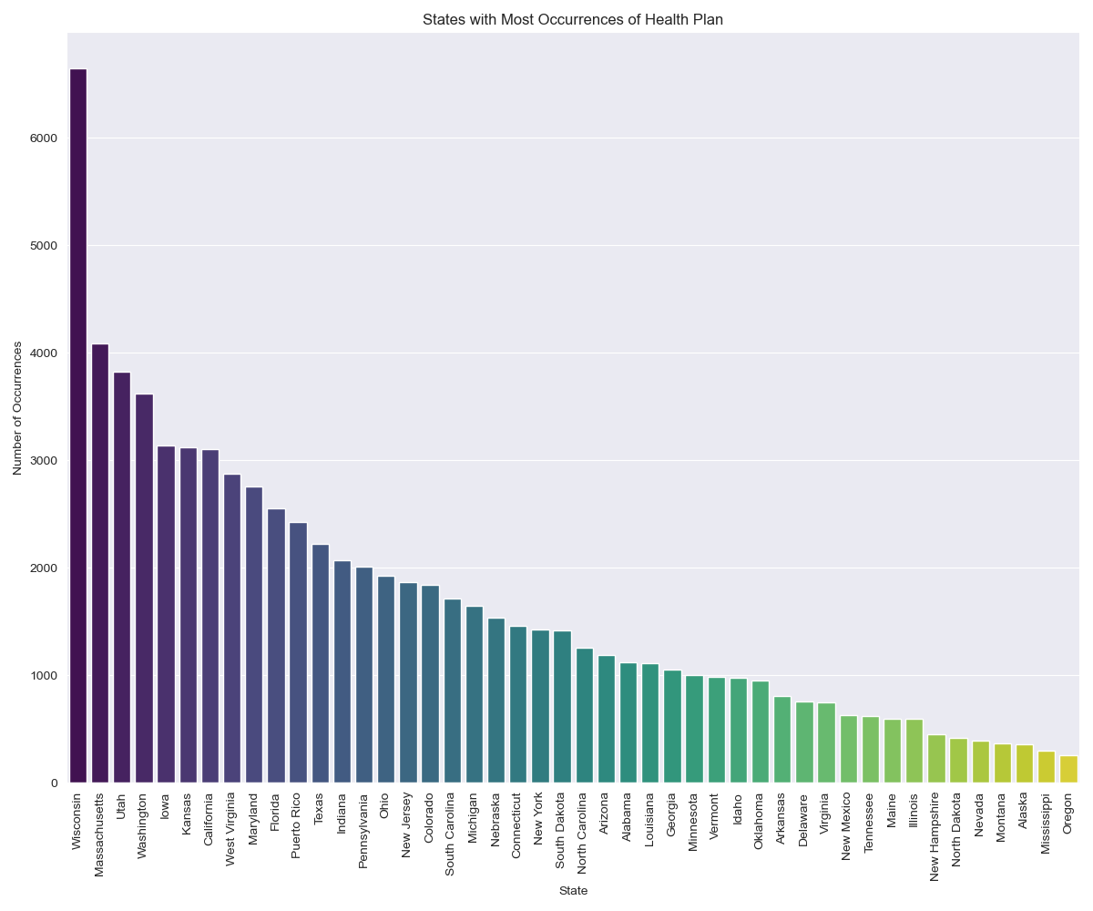

Slide 15
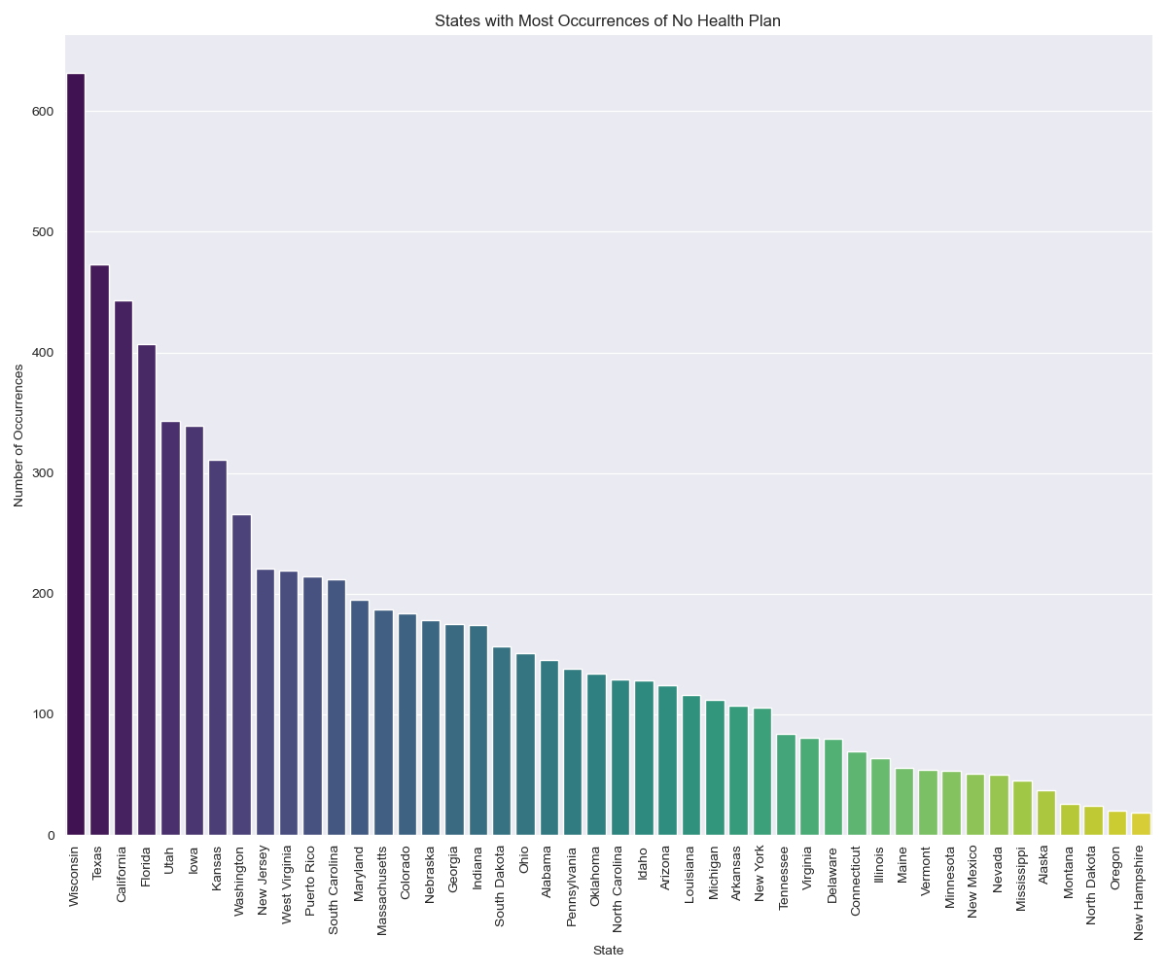

Slide 16
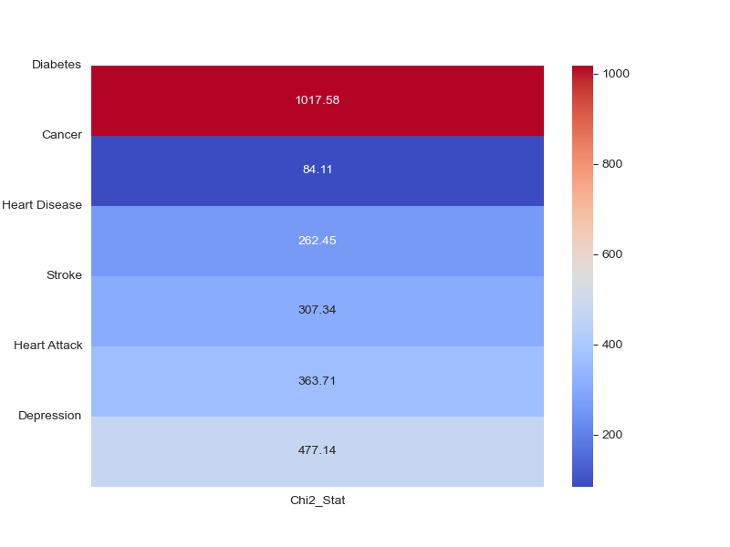
FINDINGS AND RESULTS
RESEARCH QUESTION 3
How does regular physical exercise influence tangible health outcomes, such as the risk of developing cancer, and mental health outcomes, including the likelihood of being diagnosed with depression?
Findings of research:
Pedersen, B. K., & Saltin, B. (2015).
Conducted analysis of Systematic Reviews, meta-analysis and randomized control trials.
In many instances, exercise therapy is on par with, if not superior to, medical treatments in efficacy.
Chi Squared Test of Association between Exercise and Chronic Diseases:
**The Chi-Squared Test is a non-parametric test for comparing two categorical variables in a large dataset to see if any association exists but does not imply any causation.**
Exercise Vs Chronic Diseases

Slide 17
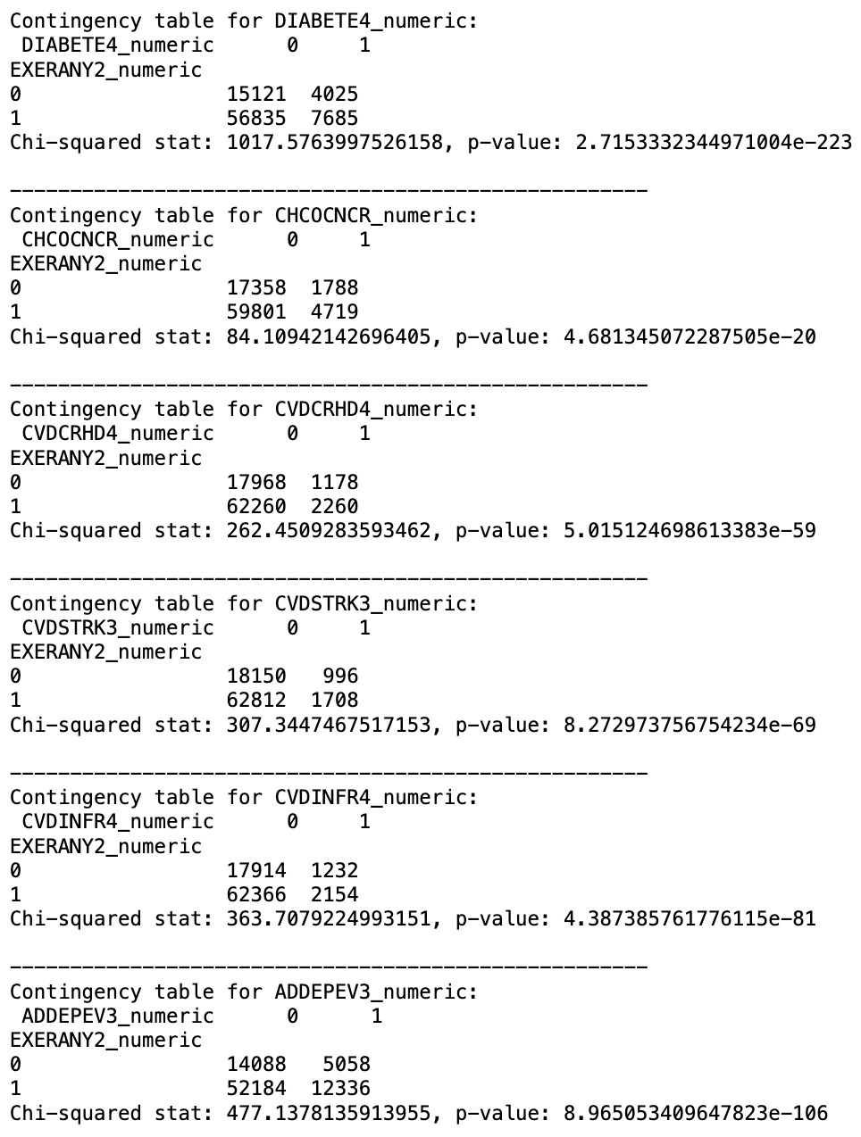
FINDINGS AND RESULTS
Contingency Table:
Helps Us to see the direction of Association Between Exercise and Each Chronic Disease
There is a clear strong Inverse Association with Exercise and Chronic Diseases.

Slide 18
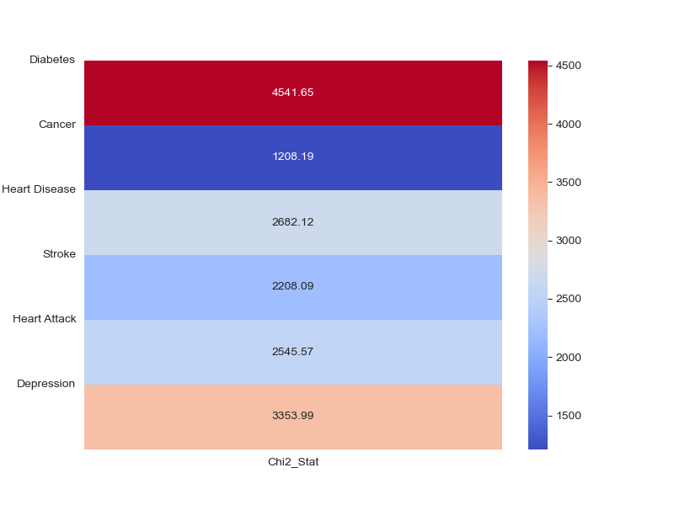
FINDINGS AND RESULTS
RESEARCH QUESTION 4
Is there a correlation between Chronic conditions and individuals self-assessed health status?
Findings of research:
Barreto and Figueiredo (2009).
Conducted Telephone based surveillance of risk Survey Analysis
“Chronic disease reporting was higher among older men and women with lower schooling, BMI > or = 30 kg/m2 and who were on a diet. Those men (OR: 33.61; 95% CI: 15.70;71.93) and women (OR: 13.02; 95% CI: 6.86; 24.73) who self-perceived their health as poor reported more chronic diseases. ”
Chi Squared Test of Association between Exercise and Chronic Diseases:
**The Chi-Squared Test is a non-parametric test for comparing two categorical variables in a large dataset to see if any association exists but does not imply any causation.**
Self-Perceived Health Vs Chronic Diseases

Slide 19
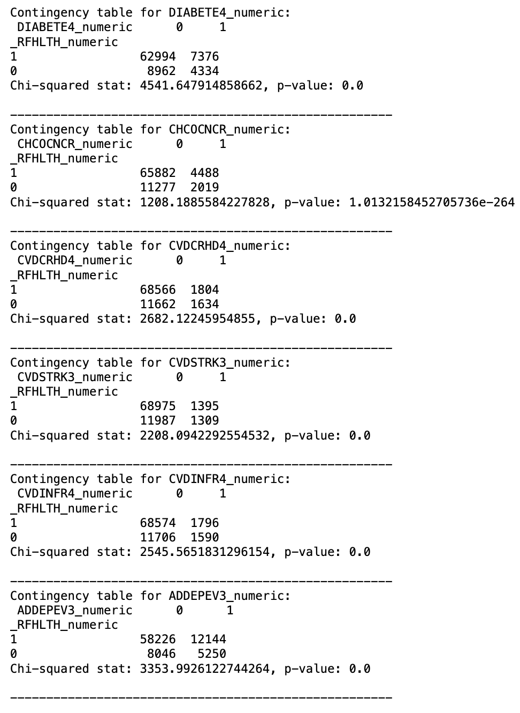
FINDINGS AND RESULTS
Contingency Table:
Helps Us to see the direction of Association Between Self-Perceived Health and Each Chronic Disease
There is a clear strong Inverse Association with Good Self-Perceived Health and Chronic Diseases.

Slide 20
FINDINGS AND RESULTS
RESEARCH QUESTION 5
Can perceived health be accurately predicted using dietary habits, socioeconomic indicators, lifestyle choices, and individual metrics?
Mbogori, T., & Arthur, T. M. (2019). Perception of Body Weight Status Is Associated with the Health and Food Intake Behaviors of Adolescents in the United States
**cross-sectional research**
(analysis of data from a population from a single timepoint)
Finding:
Adolescents who believed their weight was "just right" were more likely to describe their health status as either "very good" or "excellent."
Those perceiving their weight as "just right" consumed fruits and vegetables more frequently than their peers who saw themselves as either "underweight" or "overweight.”
Interplay between perception, health status, and dietary habits
Having this knowledge, we decided to build Models to Predict Self- Perceived Health

Slide 21
BIINARY CLASSIFICATION MODELS USING (_RFHLTH)
 | Effectiveness |  | Efficiency
MODEL | Recall (Fair/Poor Health) | Overall Accuracy | Training Time
Base Decision Tree | 54% | 87% | 106.8 seconds
Selected Features Decision Tree | 55% | 87% | 33.7 seconds
Base Logistic Regression | 79% | 84% | 172.2 seconds
Selected Features Logistic Regression | 76% | 83% | 7.4 seconds
Base Random Forrest | 51% | 88% | 1037.6 seconds
Selected Features Random Forrest | 58% | 88% | 913.2 seconds

Slide 22
MULTI-CLASS CLASSIFICATION MODELS USING (GENHLTH)
 | Effectiveness |  | Efficiency
MODEL | Recall (Fair/Poor Health) | Overall Accuracy | Training Time
Base Decision Tree | 52% | 43% | 259.2 seconds
Selected Features Decision Tree | 51% | 41% | 83.8 seconds
Base Logistic Regression | 74% | 43% | 1143.112 seconds
Selected Features Logistic Regression | 75% | 39% | 115.5 seconds
Base Random Forrest | 50% | 47% | 1692.5 seconds
Selected Features Random Forrest | 52% | 44% | 1476.5 seconds

